Slide 1
Current and future trend in global agricultural production and trade networks
Springboard Data Science Career Track -- Capstone Project 2
Shuangshuang (Sabrina) Liu
May 2020

Slide 2
Outline
Motivation
Data acquisition and cleaning
Exploratory analyses
Modeling
Deliverable
Next steps

Slide 3
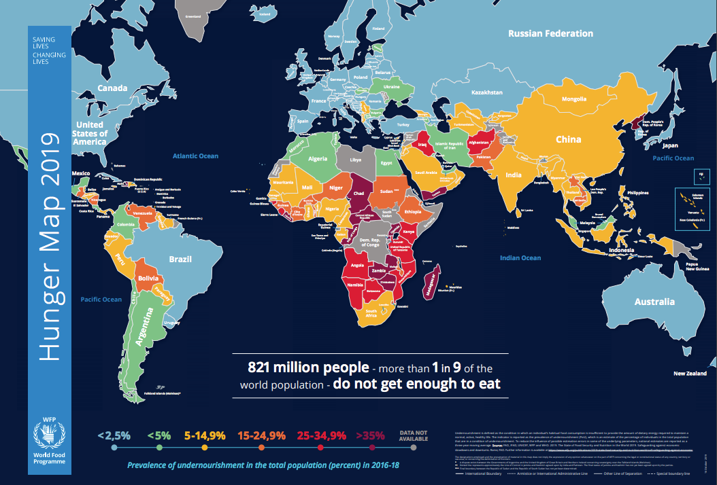
As the globe becomes more populated and warmer, not every country is well positioned to meet the food demand.
Hunger map, 2019. World Food Programme

Slide 4
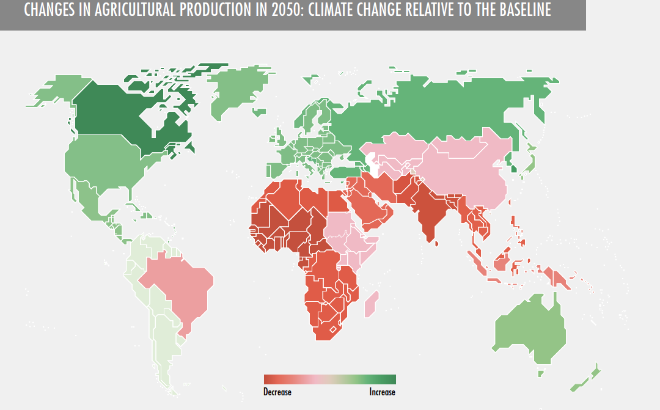
The scenario is further complicated by changes in food production and trade
http://www.fao.org/3/I9542EN/i9542en.pdf

Slide 5
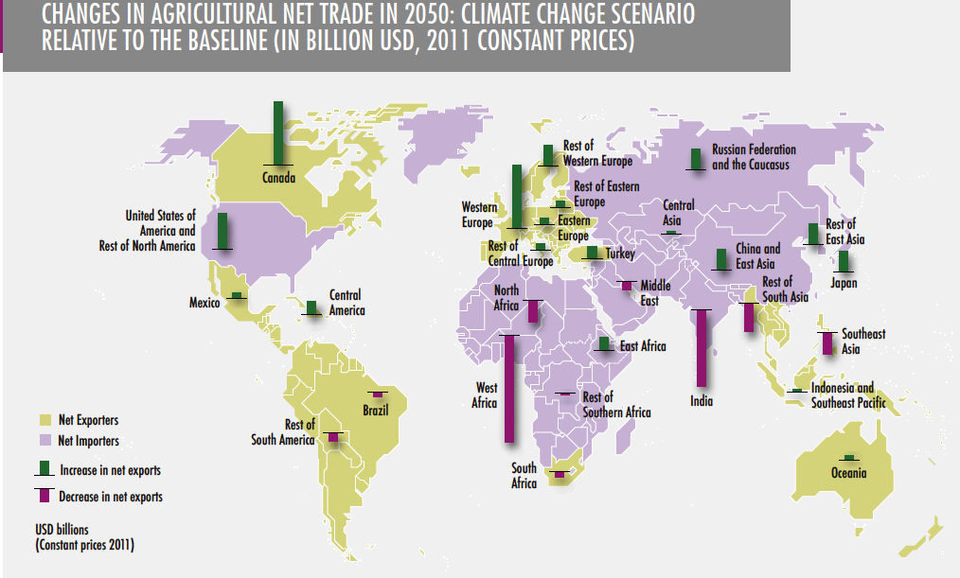
http://www.fao.org/3/I9542EN/i9542en.pdf

Slide 6
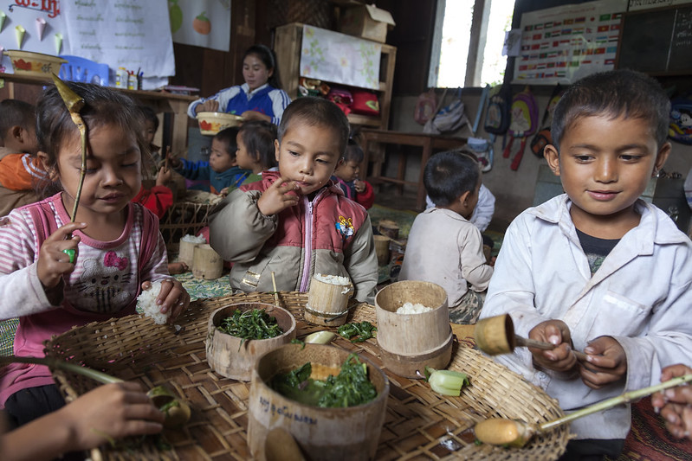
To produce more, or to trade more?
It is a difficult issue that relevant organizations across all levels should consider.
“Should the focus of government intervention be primarily on increasing local food production, or should it lean more towards increasing access to food and stimulating rural development in general?”
- How to feed the world 2050.
High-level expert forum, FAO
Pictured: Laos: Nutritious meals are bringing more children to school
https://www.flickr.com/photos/worldbank/8780908509
Notes:
For local governments, NGOs, businesses and farmers, how can they conveniently obtain an overview and forecast of the production and trade of agricultural commodities, so as to aid their decision making?
It requires data and modeling expertise that not all these organizations have access to.

Slide 7
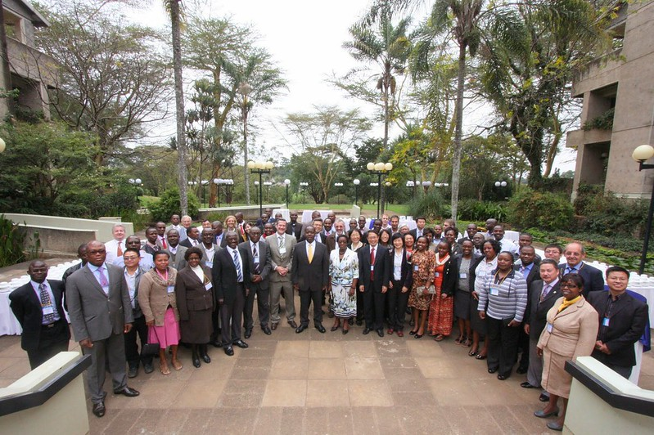
It can help, if data and forecasts on food production and trade are conveniently available to the public
Pictured: UNESCO hosted workshop which encourages the development of Open Data for use in science and sustainability in developing countries
(https://www.flickr.com/photos/unescoafrica/15334500026/in/photostream/)

Slide 8
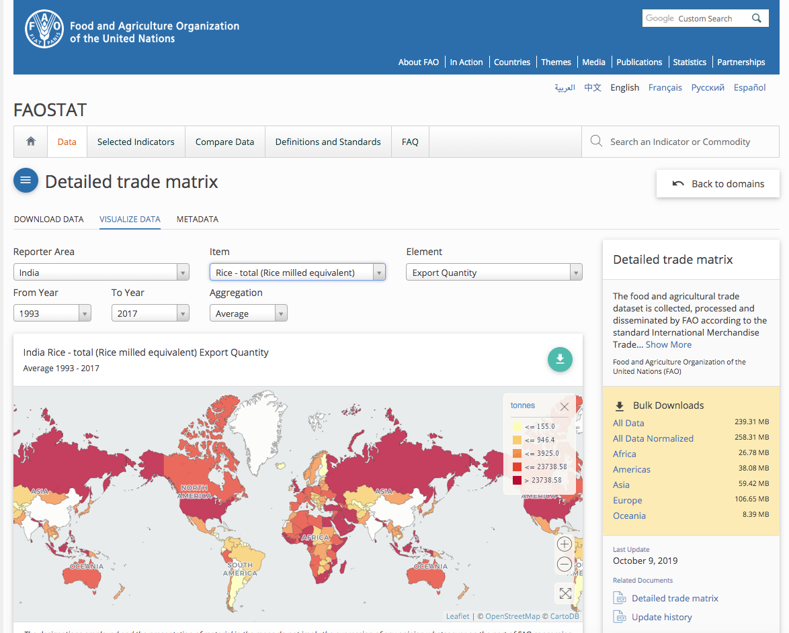
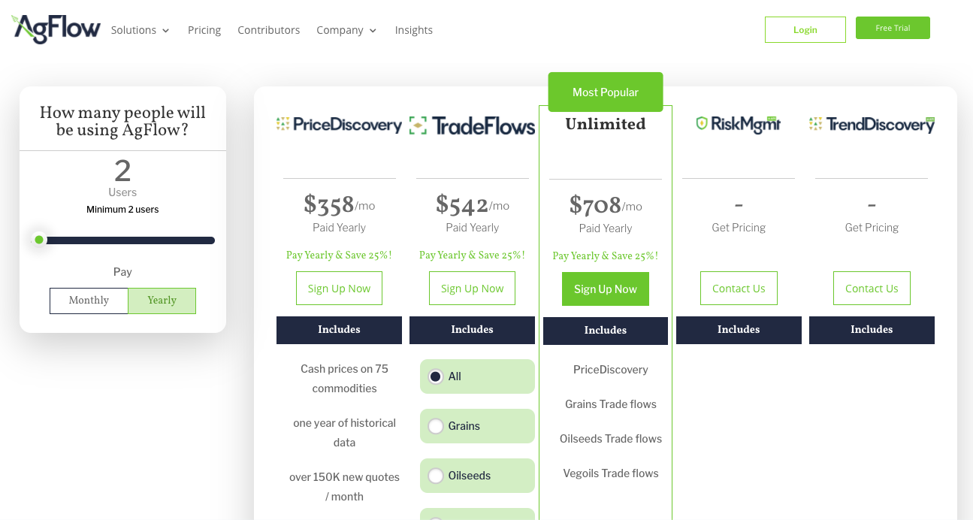
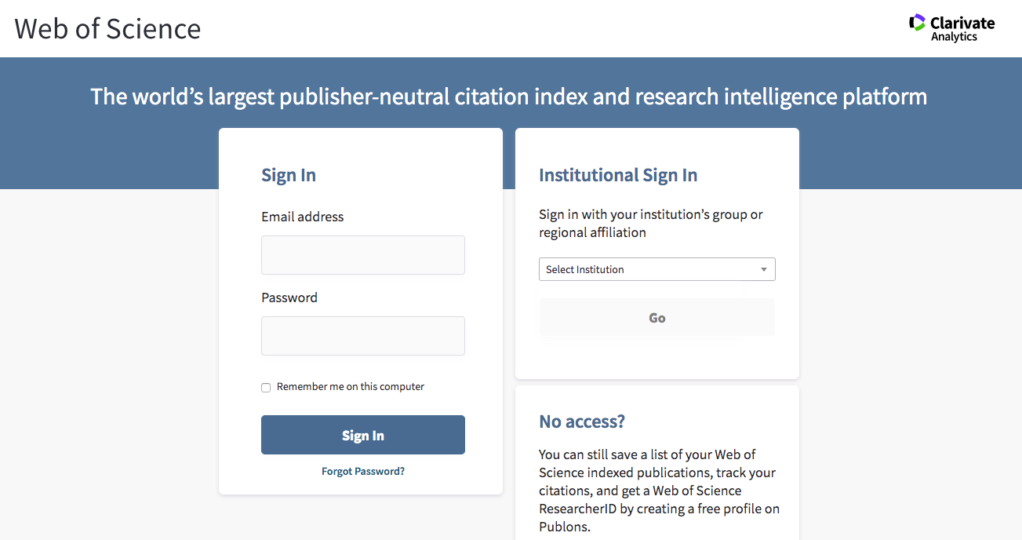
What are current options to obtain agriculture intelligence?
Options | Disadvantages
Public databases (e.g., FAO) | requires data wrangling and modeling skills to extract insights from raw data
Research publications | may require payment for access and can be hard to understand by non-technical users; limited coverage per research paper
Agricultural intelligence business platforms | More comprehensive, but considerable costs for some organizations for the information they need to acquire

Slide 9
What if we build an app which can
-pull agricultural data from public databases,
-do simple wrangling and modeling,
-make visualizations
-help non-technical users understand data and trend with just a few clicks?

Slide 10
Data acquisition and cleaning
Dataset: The food and agricultural trade dataset by FAO (http://www.fao.org/faostat/en/#data/TM)
Filtered data using Pandas by country and aggregated all trading partners for a given crop for a country together.
Discarded countries with more than 50% missing data. Used imputation to fill in missing data.
Reformatted data into time series usable by ARIMA.

Slide 11
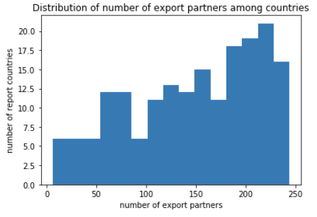
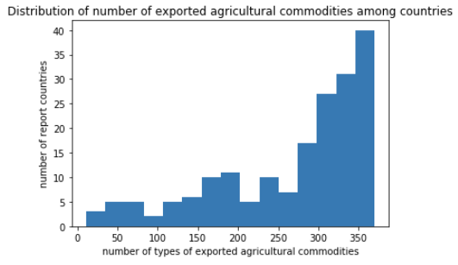
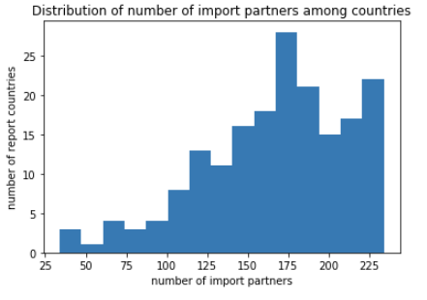
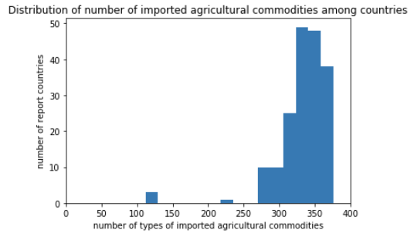
Exploratory Data Analysis
Analyzed total number of items and trading partners each country imports and exports, aka the “diversity” of countries trading.

Slide 12
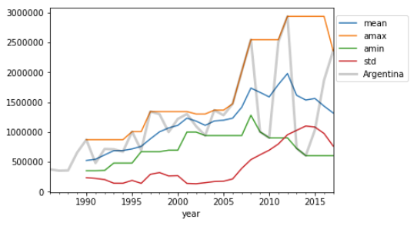
Exploratory Data Analysis
Computed statistics of every trading item (rolling averages of min, max, mean, standard deviation) across all countries in order to find appropriate features for time series modeling.
Exploratory features for wheat export by Argentina
(5-year rolling averages, tonnes)

Slide 13
Exploratory Data Analysis
Some approaches which were not pursued (preliminary modeling):
Use linear regression to predict item export quantity, treating countries as samples
Predict wheat export quantity using four other crops’ time series data, treating items as samples.
We concluded the exploratory analysis by deciding to move forward with individual time series modeling with ARIMA models on 3-year rolling mean values.

Slide 14
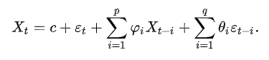
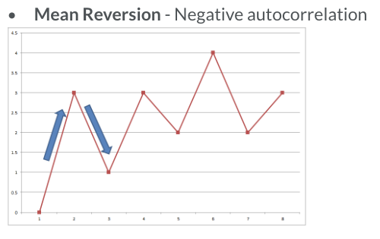
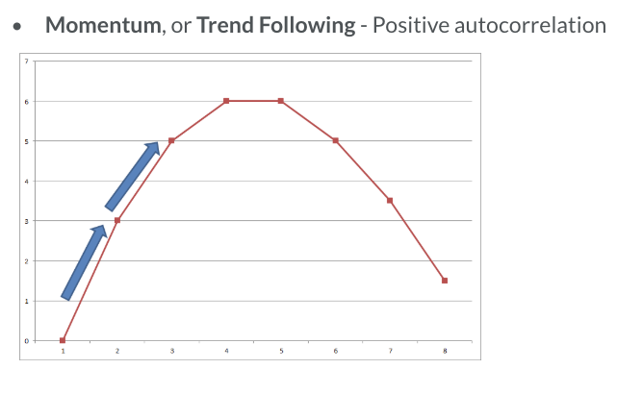
ARIMA models
ARIMA (Auto-regressive integreated moving average) is a class of models that ‘explains’ a given time series based on its own past values.
Correlations with past values analyzed include lags and the lagged forecast errors, and the resulted equation can be used to forecast future values.

Slide 15
Model Development
Used a rolling one-at-a-time approach to train ARIMA models:
Data is initially splited as 70% training and 30% testing set and the chronological order of data is maintained.
One data point from testing set is added to training set for each loop of modeling and a forecast value for the next test data is predicted.
Model is evaluated by the mean squared error(MSE) between test data and predictions.
Hyperparameters are tuned using grid search, resulting in model with min MSE.
Independent models for each item-by-country selection.
The modeling process is streamlined into a function for automation and deployed as an APP served via AWS.

Slide 16
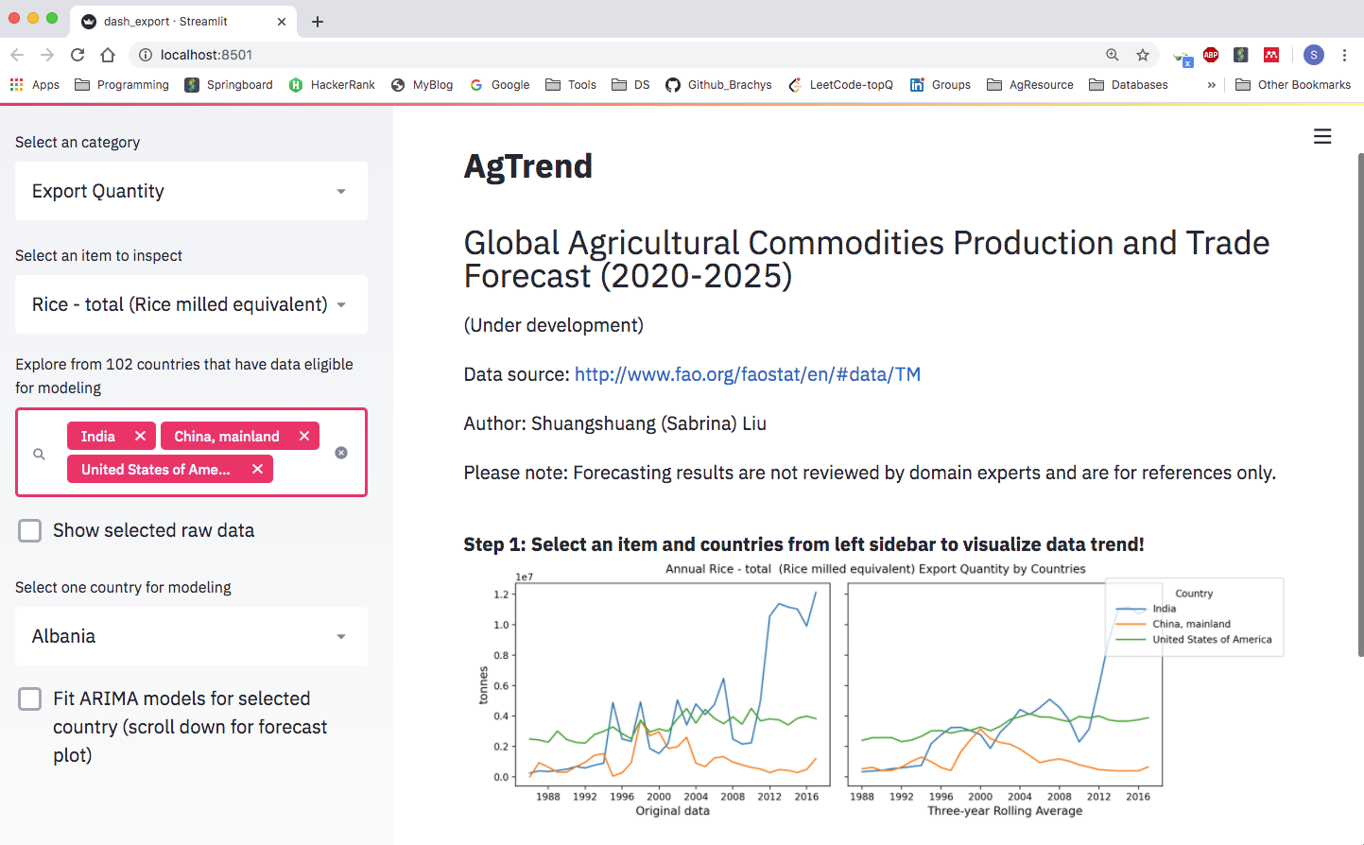
The present data science project aims to bridge this gap through a data exploratory and forecasting app, AgTrend.
Notes:
App name may need to be modified to avoid conflicts with existing names on internet

Slide 17
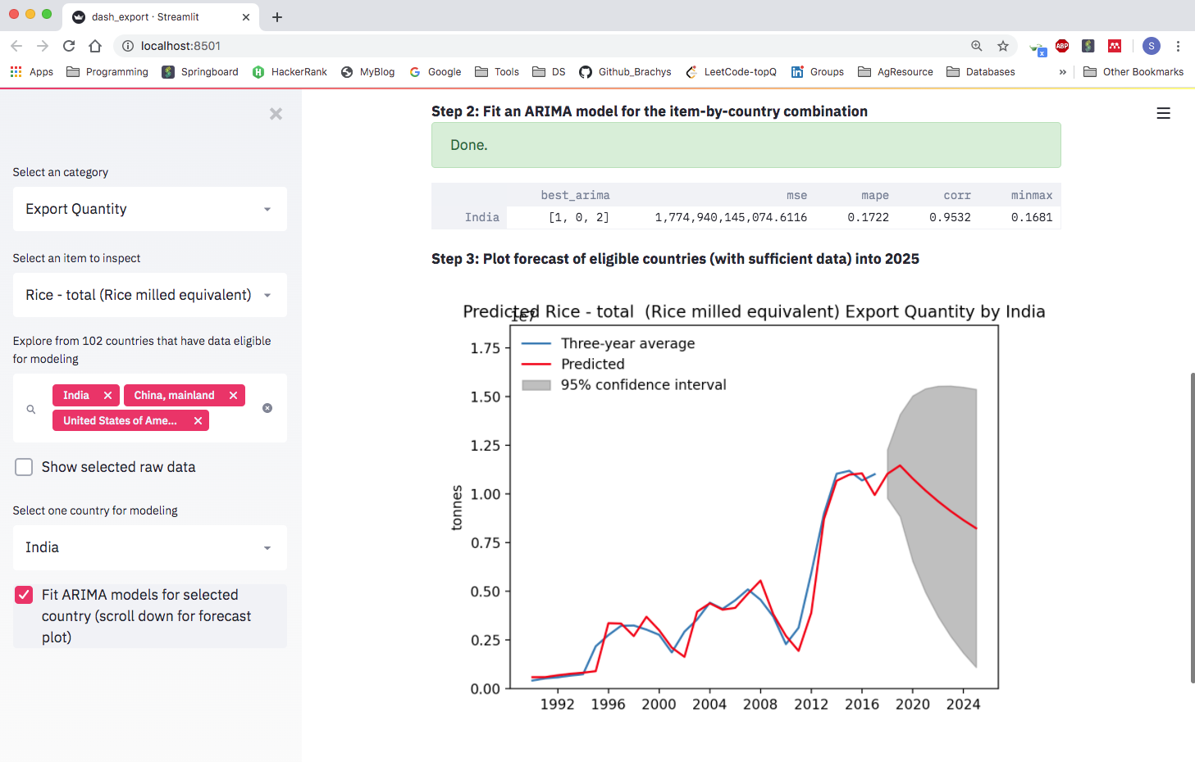
Forecasting of selected crops for specific countries are generated through a machine learning pipeline and ARIMA models, simply after a few clicks.

Slide 18
Why AgTrend?
It greatly improves the convenience of visualizing item-by-country data across years, comparing to the platform of source data.
Trends among countries can be easily compared
Most importantly, it provides forecasting on site, which is based on credible modeling procedures.
Data can be updated regularly, rendering the forecastes dynamic.

Slide 19
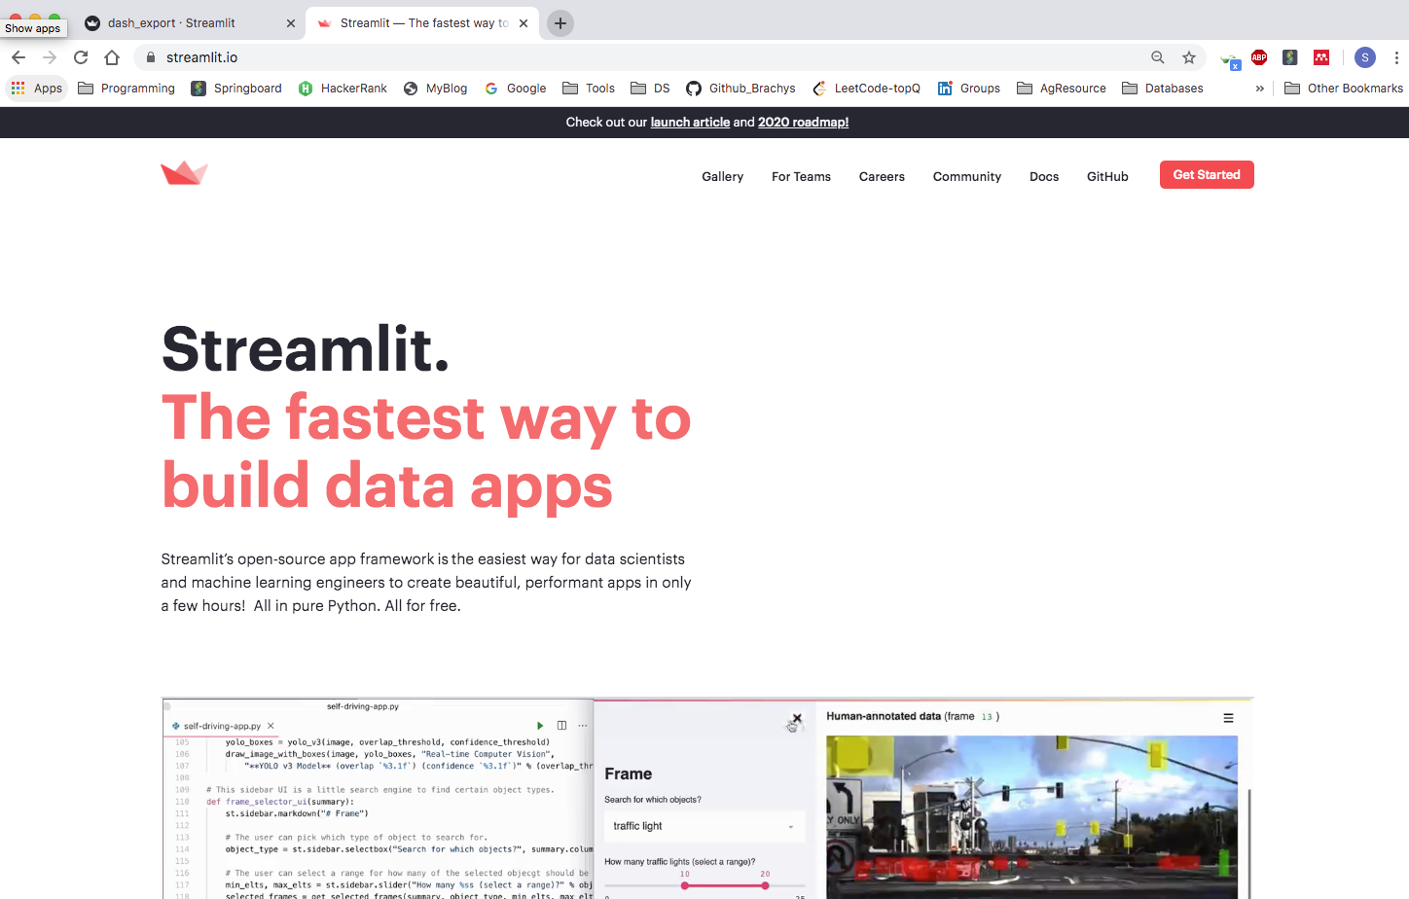
The app is powered by state-of-the-art data science tools: the Streamlit framework
https://www.streamlit.io/

Slide 20
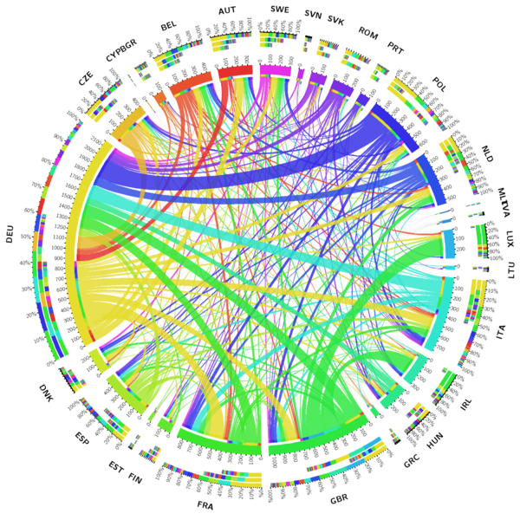
More features planned for AgTrend (stage II):
Dynamic visualization of a country’ trade network (trading partners) for selected items and its evolution over the years
Suggesting items and/or countries that have similar trading profile (e.g., diversity of trading partners and growth trends), for selected item or country
Adding climate change scenario to improve accuracy of forecasts
Notes:
image: https://upload.wikimedia.org/wikipedia/commons/thumb/f/f8/The_interrelatedness_of_the_EU_market.png/600px-The_interrelatedness_of_the_EU_market.png

Slide 21
More features planned for AgTrend (stage III):
Generate recommendations for users
Based on similarity with other country or item’s profiles, what other products or trading partners can we consider?
Based on the forecasts on trade and production, which path will better serve the food demand of the country?

Slide 22
thank you!

